Slide 1
Indexing Structures for Files
A file exists with some primary structure such as un-ordered, ordered or hashed organization.
The index structures provide secondary access paths, which provide alternative ways for accessing records without affecting the physical placement of records on the disk. They give us efficient access to records based on the indexing fields that are used to construct the index.
The most prevalent types of indexes are based on ordered files (single level index) and tree data structures (multilevel indexes).

Slide 2
Types of Single-level Ordered Indexes
The index stores each indexing fields along with a list of pointers to all disk blocks that contain records with that field value.
The values in index are ordered so that we can do binary search on the index. The index file is much smaller than data file.
There are several types of ordered indexes. They are as follows:
- Primary Index > is specified on the ordering key field of an ordered file.
- Clustering Index > is also specified on ordering field but the ordering field is not a key field.
- Secondary Index > is specified on any non-ordering field of a file.

Slide 3
Primary Indexes
A primary index is an ordered file whose records are fixed length with two fields. The first field is the ordering key field – called primary key of the data file and the second field is a pointer to a disk block.
There is one index entry (index record) in the index file for each block in the data file. The total number of records in index file is equal to the total number of blocks in the ordered data file. The first record in each block is called the anchor record.
A dense index has an index entry for every search key value in the data file.
A sparse index, on the other hand, has index entries for only some of the search values. Hence, primary index is sparse index.
If the primary index file contains b_{i} blocks, then to locate a record with a search key value requires a binary search of that index file and access to the block containing that record: a total of log₂b_{i} + 1 access.

Slide 4
Primary Indexes (contd.)
Example 1: We have an ordered file with r = 30,000 records stored on a disk with block size B = 1024 bytes. File records are of fixed size, with record length R = 100 bytes. Suppose that the ordering key field is V = 9 bytes long, a block pointer is P = 6 bytes long and we have constructed a primary index for the data file. Calculate the number of blocks to be accessed if we use binary search on data to retrieve a record. Also calculate the number of blocks to be accessed if we use index to retrieve a record.
ANS- The blocking factor for the data file is bfr = B/R =(1024/100) = 10. The number of blocks needed for the data file b = r/bfr = (30,000/10) = 3000. A binary search on the data file would need approximately ┌ log₂b = log₂ 3000 ┐= 12 block accesses.
The size of each index entry is Ri = 9 + 6 = 15 bytes, so the blocking factor bfri = B/Ri = 1024/15 = 68 entries per block. The total number of index records is equal to the number of blocks needed for data file. i.e 3000 for this case. The number of index blocks bi = 3000/68 = 45 blocks. To perform a binary search on a index file would need log₂bi = log₂45 = 6 block accesses. To search for a record using the index, we need one additional block access to the data file for a total of 6 + 1 = 7 block accesses.

Slide 5
Primary Indexes (contd.)
A major problem with a primary index is insertion and deletion of records. If we attempt to insert a record in its correct position in the data file, we have to not only move records to make space for new record but also change some index entries, since moving records will change the block anchors of some blocks.

Slide 6
Clustering Indexes
If records of a file are physically ordered on a non-key field that field is called clustering field. We can create a different type of index, called a clustering index, to speed up retrieval of records that have the same value for the clustering field.
A clustering index is also an ordered file with two fields; the first is of the same type as the clustering field of the data file, and second field is a block pointer. There is one entry in the clustering index for each distinct value of the clustering field, containing the value and a pointer to the first block in the data file that has a record with that value of the clustering field.
The record insertion and deletion cause problems, because the data records are physically ordered. To alleviate the problem of insertion, it is common to reserve a whole block for each value of the clustering field.

Slide 7
Secondary Indexes
A secondary index provides a secondary means of accessing a files for which some primary access already exists. The secondary index may be on a field which is a key or a non-key value.
The index is an ordered file with two fields. The first field is non-ordering data field and the second field is either a block pointer or record pointer. There can be many secondary indexes for the same file.
Suppose the secondary index is created on non-ordering key field of a data file. In this case is one entry for each record in the data. Hence, such an index is dense. See the figure.

Slide 8
Secondary Indexes (contd.)
Example 2: Consider the file of Example 1. Suppose the key attribute is not ordered. To do a linear search on the file, we would require b/2 = 3000/2 = 1500 block accesses on the average. Now suppose that we construct a secondary index on key field of the file that is V = 9 bytes long and block pointer is p = 6 bytes long. So the blocking factor = 1024/15 = 68 entries per block. In dense secondary index such as this, the total number of records is equal to the number of records in the data file, which 30,000. So number of blocks needed for index is 30000/68 = 442. A binary search on this index needs log₂442 = 9 blocks. To search for a record using the index, we need to 9 + 1 =10 block accesses.

Slide 9
Secondary Indexes (contd.)
We can also create a secondary index on a non-key field of a file. There are several options for implementing such as index and one of the is described below.
In this option, the index entries are at a fixed length and have a single entry for each field value but to create an extra level of indirection to handle the multiple pointers.
An Example

Slide 10
Multi-level Indexes
A binary search is applied to an index file to locate pointers to a disk block or a record in the file having a specific index field value. At each step of binary search algorithm reduces the part of the index file that we continue to search by a factor of 2.
The idea behind a multilevel index is to reduce the part of the index file that we continue to search by bfr, the blocking factor for the index, which is greater than 2. The value of bfr is called the fan-out (fo) of the multilevel index.
A multilevel index considers the index file, which refers as first (base) level of a multilevel index, as an ordered file with a distinct value for each K (i). A primary index for the first level can be created. This index to the first level is called the second level. This process can be repeated until all the entries of some index level t fit in single block.
If there are r₁ entries at the first level, and fo is the fan-out, then t = log_{fo}(r₁).

Slide 11
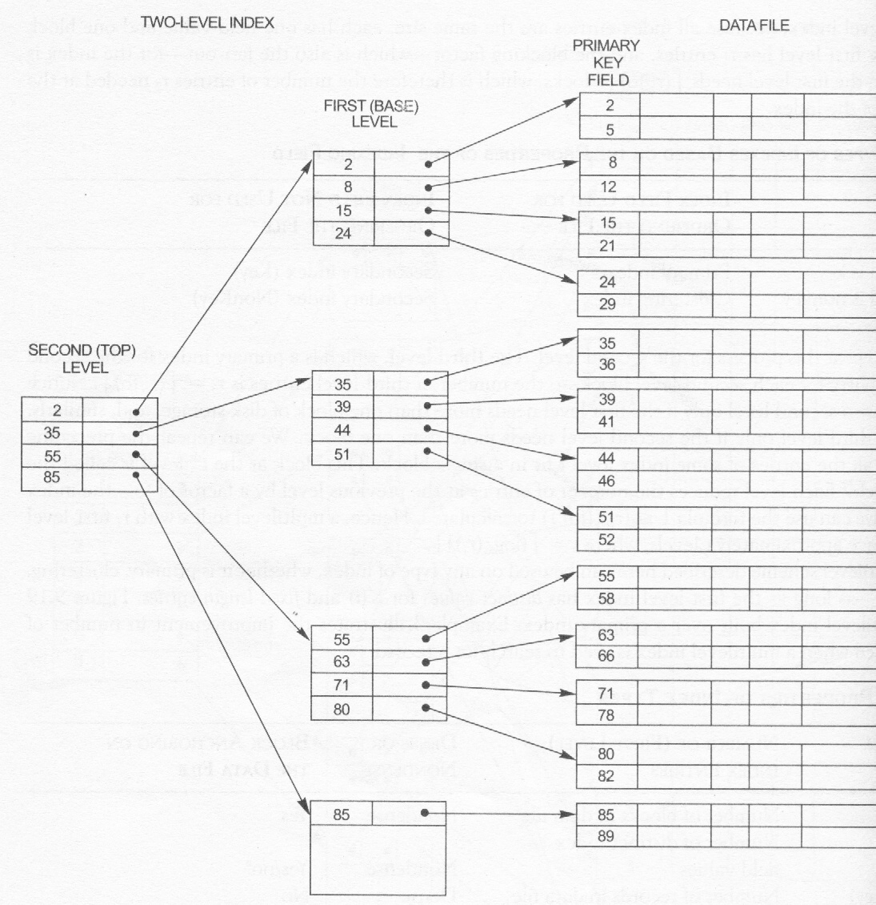
An Example of multilevel index

Slide 12
Multi-level Indexes (Contd.)
EXAMPLE 3: Suppose that the dense secondary index of Example 2 is converted into a multilevel index. We calculated the index blocking factor bfr, = 68 index entries per block, which is also the fan-out f_{o} for the multilevel index; the number of first-level blocks b₁ = 442 blocks was also calculated. The number of second level blocks will be b₂ = [(b1/fo)] = [(442/68)] = 7 blocks, and the number of third-level blocks will be b3 = (b2/fo) = [(7/68)] = 1 block. Hence, the third level is the top level of the index, and t = 3. To access a record by searching the multilevel index, we must access one block at each level plus one block from the data file, so we need t + 1 = 3 + 1 =4 block accesses. Compare this to Example 2, where 10 block accesses were needed when a single-level index and binary search were used.

Slide 13
Dynamic Multilevel Indexes using B and B⁺ trees
Search Trees: A search tree of order p is a tree such that each node contains at most p – 1 search values and p pointers in the order < P₁,K₁, P₂, K₂, …………K_{q-1}, P_{q}> where q <= p; each P_{i} is a pointer to a child node (or a null pointer) and; each K_{i} is a search value from some ordered set of values. All the search values are assume to be unique.
Two constraints must hold at all times on the search tree:
- Within each node, K₁ < K₂ < ……………< K_{q-1}.
- For all values X in the sub-tree pointed at P_{i}, we have K_{i-1}< X<K_{i} for 1< I <q_{i}; X < K_{i} for i = 1 and K_{i-1} for i = q.

Slide 14
B-tree Indexes
Definition of a B tree: A B-tree of order p is an m-way tree (i.e. a tree where each node may have up to p children) in which:
- Each internal node in B-tree is of the form
<P₁,<K₁,Pr₁>, P₂,<K₂,Pr₂>,…………….,<K_{q-1},Pr_{q-1}>P_{q}> where q <= p. Each P_{i} is a tree pointer. Each Pr_{i} is a data pointer.
- Within each node, K₁ < K₂ <………….<K_{q-1}
- For all search key field values X in the sub-tree pointed by P_{i}, we have K_{i-1} < X < K_{i} for 1< i < q; X < K_{i} for i = 1; and K_{i-1} < X for i = q
- Each node has at most p pointer
- Each node, except the root and leaf nodes, has at least ┌ (p/2)┐tree pointers. The root nodes has at least two tree pointers unless it is the only node in the tree
- A node with q tree pointer has q –1 search key field values.
- All leaf nodes are at the same level.

Slide 15
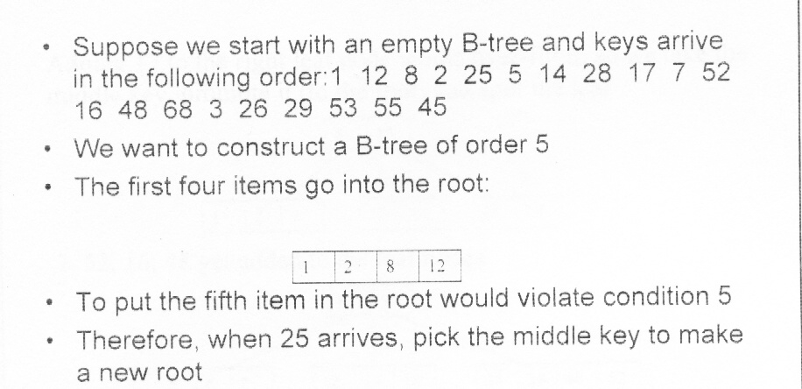
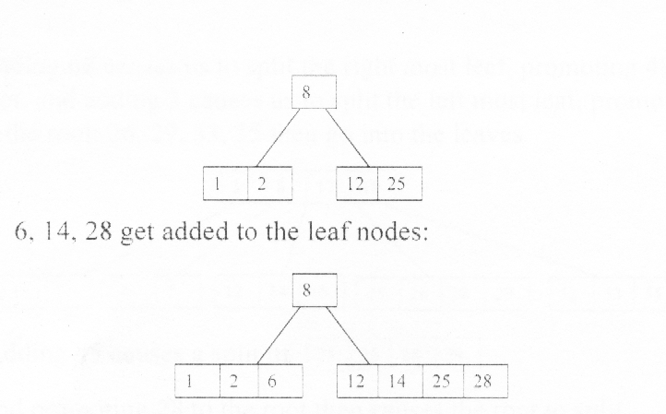
Construction of a B-tree

Slide 16
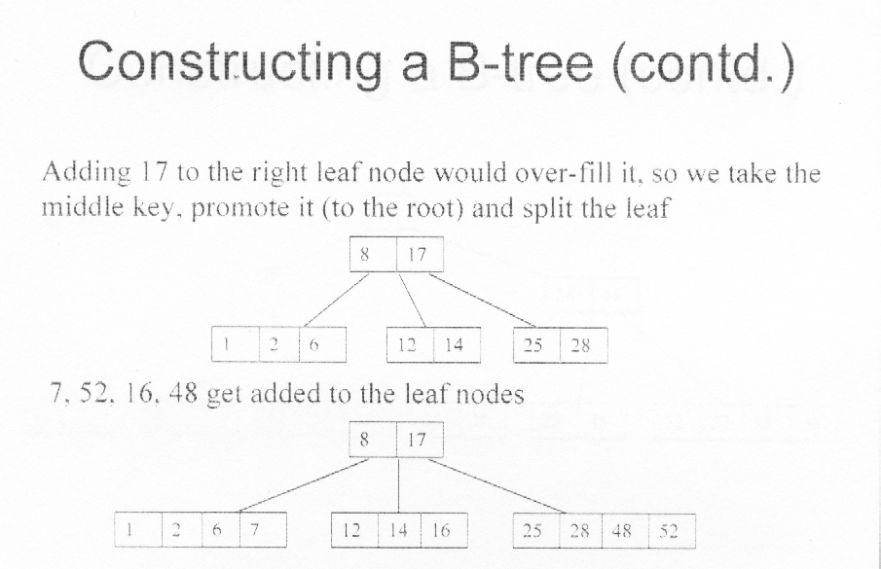
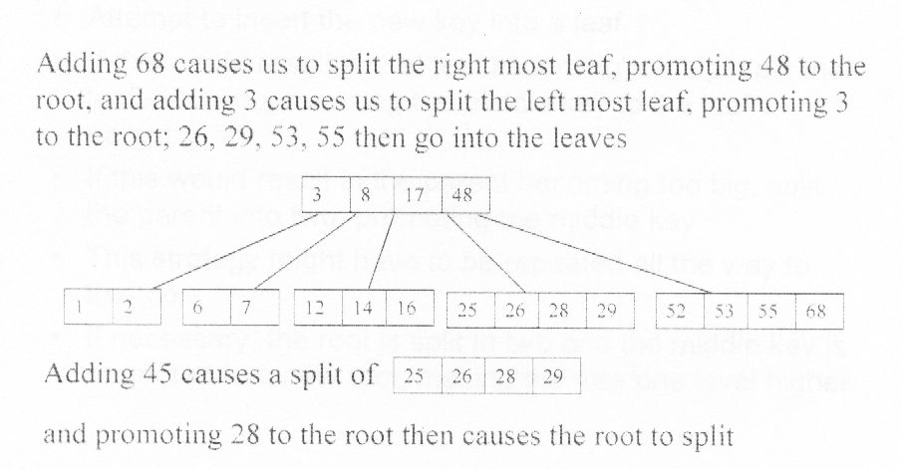

Slide 17
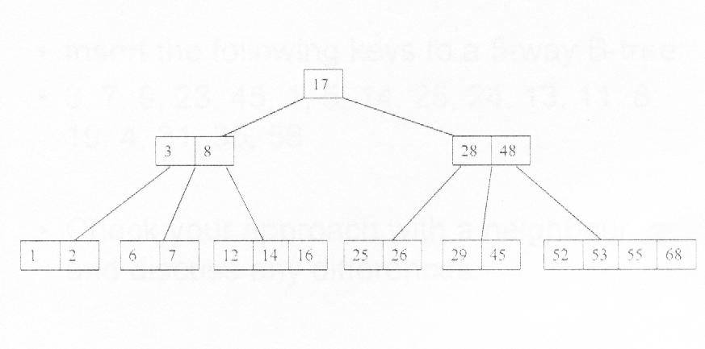
Construction of a B-tree

Slide 18
Inserting into a B-Tree
Attempt to insert the new key into a leaf
If this would result in that leaf becoming too big, split the leaf into two, promoting the middle key to the leaf's parent
If this would result in the parent becoming too big, split the parent into two, promoting the middle key
This strategy might have to be repeated all the way to the top
If necessary, the root is split in two and the middle key is promoted to a new root, making the tree one level higher

Slide 19
Removal from a B-tree
During insertion, the key always goes into a leaf. For deletion we wish to remove from a leaf. There are three possible ways we can do this:
If key is already in a leaf node, and removing it does not cause that leaf node to have too few keys, then simply remove the key to be deleted.
If the key is not in a leaf node then it is guaranteed that its predecessor or successor will be in a leaf – in this case can we delete the key and promote the predecessor or successor key to the non-leaf deleted key’s position.
If (1) or (2) lead to a leaf node containing less than the minimum number of keys then we have to look at the siblings immediately adjacent to the leaf in question:
- if one of them has more than the minimum number of keys then we can promote one of its keys to the parent and take the parent key into our lacking leaf.
- if neither of them has more than minimum number of keys then the lacking leaf and one of its neighbours can be combined with their shared parent and the new leaf will have the correct number of keys; if this step leave the parent with too few keys then we repeat the process up to the root itself, if required.

Slide 20
B⁺ Trees
Dynamic multilevel indexes usually use a variation of the B-tree data structure called a B⁺ -tree.
In a B⁺ tree, data pointers are stored only at the leaf nodes of the tree; hence, the structure of leaf nodes differs from the structure of internal nodes.
The leaf nodes have an entry for every value of the search field along with a data pointer to the record.
Some search field values from the leaf nodes are repeated in the internal nodes.
An Example

Slide 21
Example
Consider a disk with block size B=512 bytes. A block pointer is P=6 bytes long, and a record pointer is P_{R} =7 bytes long. A file has r=30,000 EMPLOYEE records of fixed-length. Each record has the following fields: NAME (30 bytes), SSN (9 bytes), DEPARTMENTCODE (9 bytes), ADDRESS (40 bytes), PHONE (9 bytes), BIRTHDATE (8 bytes), SEX (1 byte), JOBCODE (4 bytes), SALARY (4 bytes, real number).

Slide 22
Example
Suppose the file is ordered by the key field SSN and we want to construct a primary index on SSN. Calculate (i) the index blocking factor bfr i (which is also the index fan-out fo);
(ii) the number of first-level index entries and the number of first-level index blocks;
(iii) the number of levels needed if we make it into a multi-level index;
(iv) the total number of blocks required by the multi-level index.
(v) the number of block accesses needed to search for and retrieve a record from the file—given its SSN value—using the primary index.

Slide 23
Suppose the file is not ordered by the key field Ssn and we want to construct a B + -tree access structure (index) on SSN. Calculate (i) the orders p and p leaf of the B + -tree;
(ii) the number of leaf-level blocks needed if blocks are approximately 69% full (rounded up for convenience);
(iii) the number of levels needed if internal nodes are also 69% full (rounded up for convenience);
(iv) the total number of blocks required by the B + -tree; and
(v) the number of block accesses needed to search for and retrieve a record from the
file—given its SSN value— using the B + -tree.

